Slide 1
Module 1: Windows Server Overview
CIT 0553 : OPERATING SYSTEMS ADMINISTRATION 1
Diploma in Cyber Security Technology
Computer & Information Department
German-Malaysian Institute
Notes:
Cisco Networking Academy Program
Switching, Routing and Wireless Essentials v7.0 (SRWE)
Module 1: Basic Device Configuration

Slide 2
1.1 Types of Windows Server
Notes:
1- Basic Device Configuration
1.1 – Configure a Switch with Initial Settings

Slide 3
1.1 Types of Windows Server
1.1.1 Windows 2000 Server
Notes:
1- Basic Device Configuration
1.1 – Configure a Switch with Initial Settings

Slide 4
1.1.1 Windows 2000 Server
  Is an edition of Windows 2000 released on February 17, 2000. It features many system-wide improvements over its predecessor Windows NT 4.0 Server.
  It provides application development services as well as connectivity, file and storage management enhancements, in addition to reliability, scalability, security, systems management and Web integration improvement

Slide 5
1.1.1 Windows 2000 Server
Windows 2000 Server Editions
  Windows 2000 Server
    an entry-level server designed for use in small and midsize businesses as a file, print, intranet and infrastructure server.
  Windows 2000 Advanced Server
    designed for line-of-business applications and e-commerce, Advanced Server contains all the functionality and reliability of the entry-level version of Windows 2000 Server, plus additional features, such as clustering and network load balancing for applications that require higher levels of scalability and availability. It is suitable for departmental applications, such as networking, messaging, inventory and customer service systems, databases and e-commerce Web sites.

Slide 6
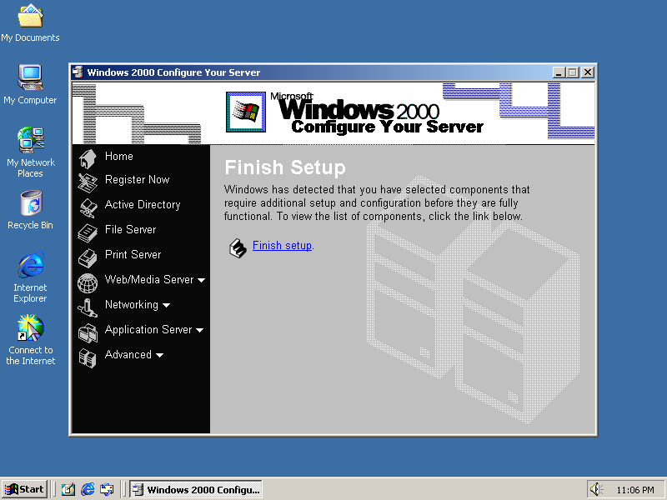
1.1.1 Windows 2000 Server
Windows 2000 Server Editions
  Windows 2000 Datacenter Server
    designed to support more than 10,000 simultaneous users in a variety of technical and data-intensive environments, including data warehousing, econometric analysis, large-scale engineering and science simulations, online transaction processing (OLTP), server consolidation, and Internet service provider (ISP) and site hosting. This version is available through OEM channels only.

Slide 7
1.1 Types of Windows Server
1.1.2 Windows 2003 Server
Notes:
1- Basic Device Configuration
1.1 – Configure a Switch with Initial Settings

Slide 8
1.1.2 Windows 2003 Server
  Released on April 24, 2003, Windows Server 2003 (which carries the version number 5.2) is the follow-up to Windows Server 2000, incorporating compatibility and other features from Windows XP.
  Unlike Windows Server 2000, Windows Server 2003's default installation has none of the server components enabled, to reduce the attack surface of new machines. Windows Server 2003 includes compatibility modes to allow older applications to run with greater stability. It was made more compatible with Windows NT 4.0 domain-based networking.
  Incorporating and upgrading a Windows NT 4.0 domain to Windows 2000 was considered difficult and time consuming, and generally was considered an all-or-nothing upgrade particularly when dealing with Active Directory. Windows Server 2003 brought in enhanced Active Directory compatibility, and better deployment support, to ease the transition from Windows NT 4.0 to Windows Server 2003 and Windows XP Professional.

Slide 9
1.1.2 Windows 2003 Server
Windows 2003 Server Editions
  Windows 2003 Server Web Edition
    Windows Server 2003 Web Edition is mainly for building and hosting Web applications, Web pages, and XML Web Services.
    It is designed to be used primarily as an IIS 6.0 Web server and provides a platform for rapidly developing and deploying XML Web services and applications that use ASP.NET technology, a key part of the .NET Framework. This edition does not require Client Access Licenses and Terminal Server mode is not included on Web Edition. However, Remote Desktop for Administration is available on Windows Server 2003, Web Edition.
    Only 10 concurrent file-sharing connections are allowed at any moment. It is not possible to install Microsoft SQL Server and Microsoft Exchange software on this version of Windows, although MSDE and SQL Server 2005 Express are fully supported after service pack 1 is installed. The most important limitation of Web edition is a maximum memory of 2 GB RAM. Additionally, Web Edition cannot act as a domain controller.

Slide 10
1.1.2 Windows 2003 Server
Windows 2003 Server Editions
  Windows 2003 Server Standard Edition
    Windows Server 2003 Standard Edition is aimed towards small to medium sized businesses. Flexible and versatile, Standard Edition supports file and printer sharing, offers secure Internet connectivity, and allows centralized desktop application deployment.
    This edition of Windows will run on up to 4 processors with up to 4 GB RAM. 64-bit versions are also available for the AMD x86-64 architecture and the Intel clone of that same architecture, EM64T. The 64-bit version of Standard Edition is capable of addressing up to 32 GB of RAM and it also supports Non-Uniform Memory Access (NUMA), something the 32-bit version does not.

Slide 11
1.1.2 Windows 2003 Server
Windows 2003 Server Editions
  Windows 2003 Server Enterprise Edition
    is aimed towards medium to large businesses. It is a full-function server operating system that supports up to eight processors and provides enterprise-class features such as eight-node clustering using Microsoft Cluster Server (MSCS) software and support for up to 32 GB of memory.
    Enterprise Edition also comes in a 64-bit edition for Intel. 64-bit versions are also available for the AMD x86-64 architecture and the Intel clone of that same architecture, EM64T. The 64-bit version of Enterprise Edition is capable of addressing up to 1 TB of RAM. Both 32-bit and 64-bit versions support Non-Uniform Memory Access (NUMA).

Slide 12
1.1.2 Windows 2003 Server
Windows 2003 Server Editions
  Windows 2003 Server Datacenter Edition
    Windows Server 2003 Datacenter Edition is designed for infrastructures demanding high security and reliability. Windows Server 2003 is available for x86 32-bit, x86 64-bit and x64 bit processors.
    It supports a minimum of 8 processors and a maximum of 64 processors, however it is limited to 32 processors when run on 32-bit architecture. 32-bit architecture also limits memory addressability to 64GB, while the 64-bit versions support up to 512 GB. Datacenter Edition also allows limiting processor and memory usage on a per-application basis.

Slide 13
1.1 Types of Windows Server
1.1.3 Windows Server 2008
Notes:
1- Basic Device Configuration
1.1 – Configure a Switch with Initial Settings

Slide 14
1.1.2 Windows 2008 Server
  Originally known as Windows Server Codename "Longhorn", Microsoft chairman Bill Gates announced its official title (Windows Server 2008) during his keynote address at WinHEC 16 May 2007.
  Beta 1 was released on 27 July 2005, Beta 2 was announced and released on 23 May 2006 at WinHEC 2006 and Beta 3 was released publicly on 25 April 2007. Release Candidate 0 was released to the general public on 24 September 2007 and Release Candidate 1 was released to the general public on 5 December 2007. Windows Server 2008 was released to manufacturing on 4 February 2008 and officially launched on 27 February 2008.

Slide 15
1.1.2 Windows 2008 Server
Windows 2003 Server Editions
  Most editions of Windows Server 2008 are available in x86-64 and IA-32 versions. These editions come in two DVDs: One for installing the IA-32 variant and the other for x64. Windows Server 2008 for Itanium-based Systems supports IA-64 processors. The IA-64 version is optimized high-workload scenarios like database servers and Line of Business (LOB) applications. As such, it is not optimized for use as a file server or media server. Windows Server 2008 is the last 32-bit Windows server operating system. Editions of Windows Server 2008 include:
  Windows Server 2008 Standard (IA-32 and x86-64)
  Windows Server 2008 Enterprise (IA-32 and x86-64)
  Windows Server 2008 Datacenter (IA-32 and x86-64)
  Windows HPC Server 2008 (Codenamed "Socrates") (replacing Windows Compute Cluster Server)

Slide 16
1.1.2 Windows 2008 Server
Windows 2003 Server Editions
    Windows Web Server 2008 (IA-32 and x86-64)
    Windows Storage Server 2008 (Codenamed "Magni") (IA-32 and x86-64)
    Windows Small Business Server 2008 (Codenamed "Cougar") (x86-64) for small businesses
    Windows Essential Business Server 2008 (Codenamed "Centro") (x86-64) for medium-sized businesses (Discontinued)
    Windows Server 2008 for Itanium-based Systems
    Windows Server 2008 Foundation (Codenamed "Lima") (x86-64) for OEMs only
  The Microsoft Imagine program, known as DreamSpark at the time, used to provide verified students with the 32-bit variant of Windows Server 2008 Standard Edition, but the version has since then been removed. However, they still provide the R2 release.

Slide 17
1.1.2 Windows 2008 Server
Windows 2003 Server Editions
  Windows 2003 Server Standard Edition
    Windows Server 2003 Standard Edition is aimed towards small to medium sized businesses. Flexible and versatile, Standard Edition supports file and printer sharing, offers secure Internet connectivity, and allows centralized desktop application deployment.
    This edition of Windows will run on up to 4 processors with up to 4 GB RAM. 64-bit versions are also available for the AMD x86-64 architecture and the Intel clone of that same architecture, EM64T. The 64-bit version of Standard Edition is capable of addressing up to 32 GB of RAM and it also supports Non-Uniform Memory Access (NUMA), something the 32-bit version does not.

Slide 18
1.1.2 Windows 2003 Server
Windows 2003 Server Editions
  Windows 2003 Server Enterprise Edition
    is aimed towards medium to large businesses. It is a full-function server operating system that supports up to eight processors and provides enterprise-class features such as eight-node clustering using Microsoft Cluster Server (MSCS) software and support for up to 32 GB of memory.
    Enterprise Edition also comes in a 64-bit edition for Intel. 64-bit versions are also available for the AMD x86-64 architecture and the Intel clone of that same architecture, EM64T. The 64-bit version of Enterprise Edition is capable of addressing up to 1 TB of RAM. Both 32-bit and 64-bit versions support Non-Uniform Memory Access (NUMA).

Slide 19
1.1.2 Windows 2003 Server
Windows 2003 Server Editions
  Windows 2003 Server Datacenter Edition
    Windows Server 2003 Datacenter Edition is designed for infrastructures demanding high security and reliability. Windows Server 2003 is available for x86 32-bit, x86 64-bit and x64 bit processors.
    It supports a minimum of 8 processors and a maximum of 64 processors, however it is limited to 32 processors when run on 32-bit architecture. 32-bit architecture also limits memory addressability to 64GB, while the 64-bit versions support up to 512 GB. Datacenter Edition also allows limiting processor and memory usage on a per-application basis.

Slide 20
1.2 Microsoft Windows Server Hardware Requirement
Notes:
1- Basic Device Configuration
1.1 – Configure a Switch with Initial Settings

Slide 21

Configure a Switch with Initial Settings
Switch LED Indicators
System LED (SYST): Shows whether the system is receiving power and functioning properly.
Redundant Power Supply LED (RPS): Shows the RPS status.
Port Status LED (STAT): When green, indicates port status mode is selected, which is the default. Port status can then be understood by the light associated with each port.
Port Duplex LED (DUPLX): When green, indicates port duplex mode is selected. Port duplex can then be understood by the light associated with each port.
Port Speed LED (SPEED): When green, indicates port speed mode is selected. Port speed can then be understood by the light associated with each port.
Power over Ethernet LED (PoE): Present if the switch supports PoE. Indicates the PoE status of ports on the switch.
The Mode button is used to move between the different modes – STAT, DUPLX, SPEED, and PoE
Notes:
1 – Basic Device Configuration
1.1. – Configure a Switch with Initial Settings
1.1.3 – Switch LED Indicators

Slide 22
1.3 Windows File System
Notes:
1- Basic Device Configuration
1.1 – Configure a Switch with Initial Settings

Slide 23
Configure a Switch with Initial Settings
Switch LED Indicators (Cont.)
 | Off | Green | Blinking Green | Amber | Blinking Amber | Alternating Green/Amber
RPS | Off/No RPS | RPS ready | RPS up but not available | RPS standby or fault | Internal PS failed, RPS providing power | N/A
PoE | Not selected, no issues | Selected | N/A | N/A | Not selected, port issues present | N/A
When the named mode is selected, the light associated with each physical port indicates:
STAT | No link or shutdown | Link Up | Activity | Port blocked preventing loop | Port blocked preventing loop | Link fault
DUPLEX | Half-duplex | Full-duplex | N/A | N/A | N/A | N/A
SPEED | 10Mbps | 100Mbps | 1000Mbps | N/A | N/A | N/A
PoE | PoE off | PoE on | N/A | PoE disabled | PoE off due to fault | PoE denied (over budget)
Notes:
1 – Basic Device Configuration
1.1. – Configure a Switch with Initial Settings
1.1.3 – Switch LED Indicators (Cont.)

Slide 24
1.4 Setting Up and Installation Methods
Notes:
1- Basic Device Configuration
1.1 – Configure a Switch with Initial Settings

Slide 25
Configure a Switch with Initial Settings
Recovering from a System Crash
The boot loader provides access into the switch if the operating system cannot be used because of missing or damaged system files. The boot loader has a command line that provides access to the files stored in flash memory. The boot loader can be accessed through a console connection following these steps:
  Step 1. Connect a PC by console cable to the switch console port. Configure terminal emulation software to connect to the switch.
  Step 2. Unplug the switch power cord.
  Step 3. Reconnect the power cord to the switch and, within 15 seconds, press and hold down the Mode button while the System LED is still flashing green.
  Step 4. Continue pressing the Mode button until the System LED turns briefly amber and then solid green; then release the Mode button.
  Step 5. The boot loader switch: prompt appears in the terminal emulation software on the PC.
The boot loader command line supports commands to format the flash file system, reinstall the operating system software, and recover a lost or forgotten password. For example, the dir command can be used to view a list of files within a specified directory.
Notes:
1 – Basic Device Configuration
1.1. – Configure a Switch with Initial Settings
1.1.4 – Recovering from a System Crash

Slide 26
1.5 Setting Up and Installation Methods
Notes:
1- Basic Device Configuration
1.1 – Configure a Switch with Initial Settings

Slide 27
1.6 Configuring Windows Server through MMC and Registry
Notes:
1- Basic Device Configuration
1.1 – Configure a Switch with Initial Settings

